Slide 1
INTRODUCTION TO MONGO DB
Presented By-
Akash Kumar Nandi
Roll No. 20223011
Preetam Mondal
Roll No.20223068

Slide 2
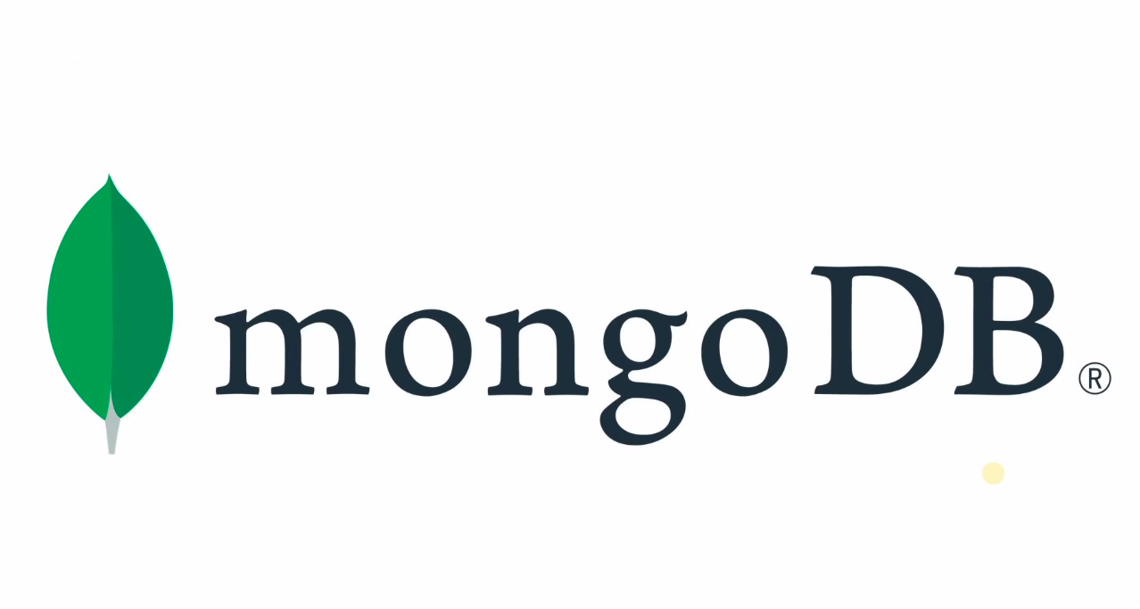

Slide 3
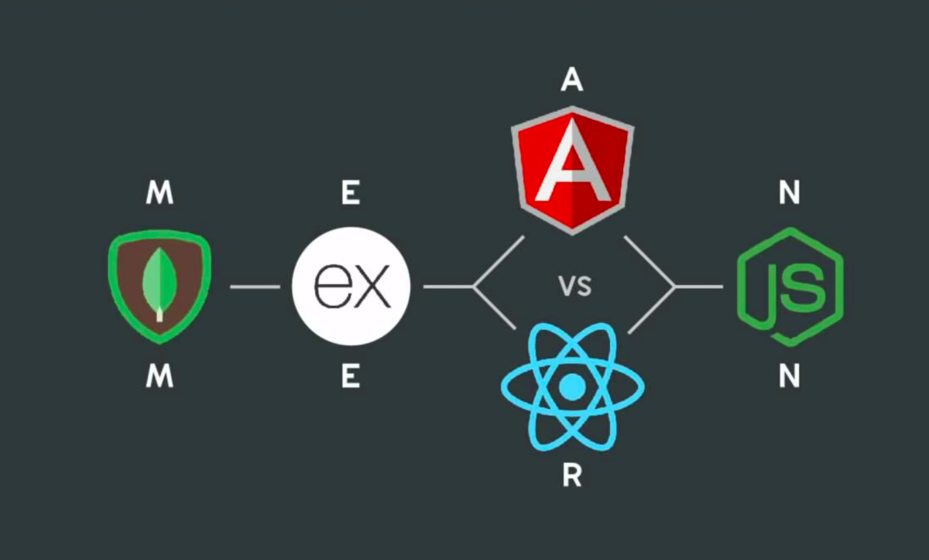

Slide 4
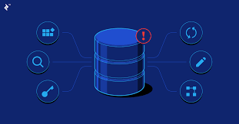
A Database is nothing but an organised collection of the data and the information which can be used for some sort of specific kind of predefined or the postdefined operations

Slide 5
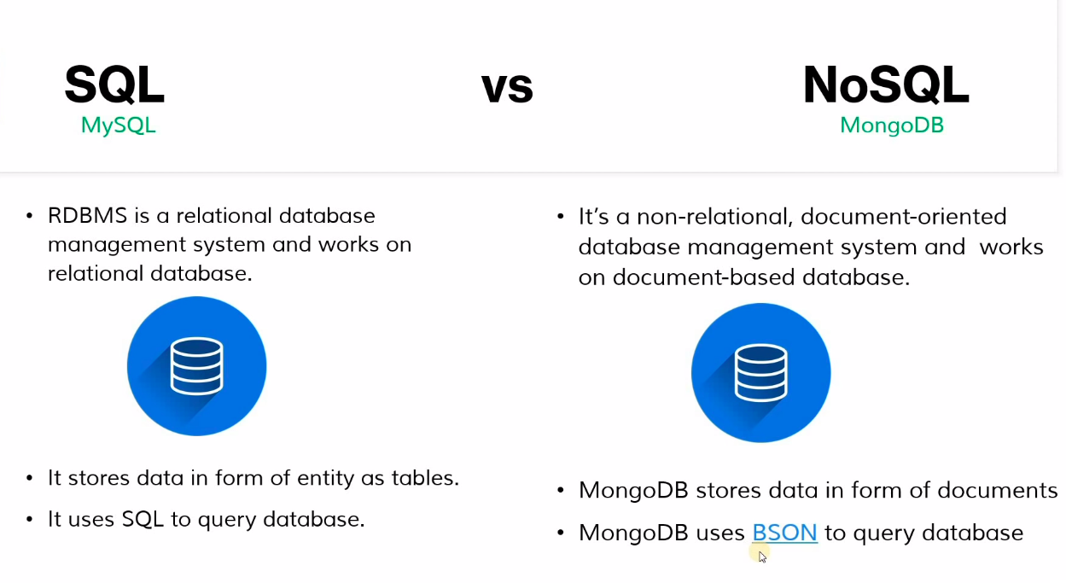

Slide 6
What is BSON and Why BSON ?
The BSON is nothing but the Binary JSON. Hence the defination says that MONGO DB stores the data in the form of Binary JSON format(BSON) which has the syntax same as JSON.
We use BSON over JSON because of the following reasons:-
JSON is the Text format hence text Parsing is very slow to operate.
JSON readable format far from the space efficiency which is not good for the Database concern.
JSON supports a limited numbers of some basic data types.

Slide 7
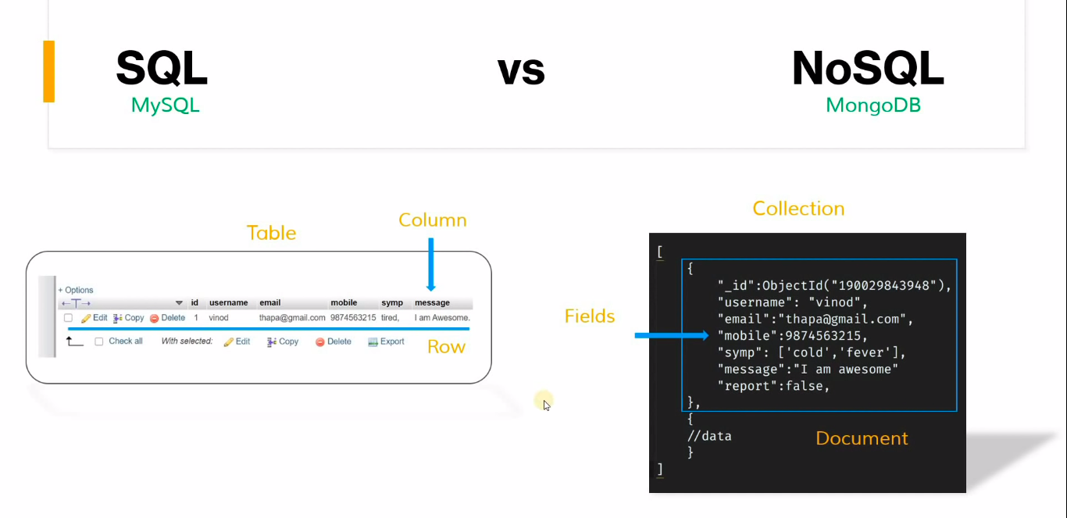

Slide 8
Why we use the NoSQL(MONGO DB) ?
MongoDB is schema-free, allowing you to create documents without having to define the structure of the document first.
These documents can be easily changed by adding or deleting fields which we can also called as scalability.

